Slide 1

Machine learning
Welcome TO
Professor: CVSN Reddy By: Bhavana M

Slide 2

What is Artificial intelligence & Machine Learning
Using human intelligence in machines is AI
Making the machines to learn is ML

Slide 3



Types of machine learning
Supervised learning (SL)– When you learn from someone under their supervision
Unsupervised learning(USL) – Learning on your own with none’s supervision
Reinforcement learning (RL)– Learning for rewards with rules and regulations

Slide 4
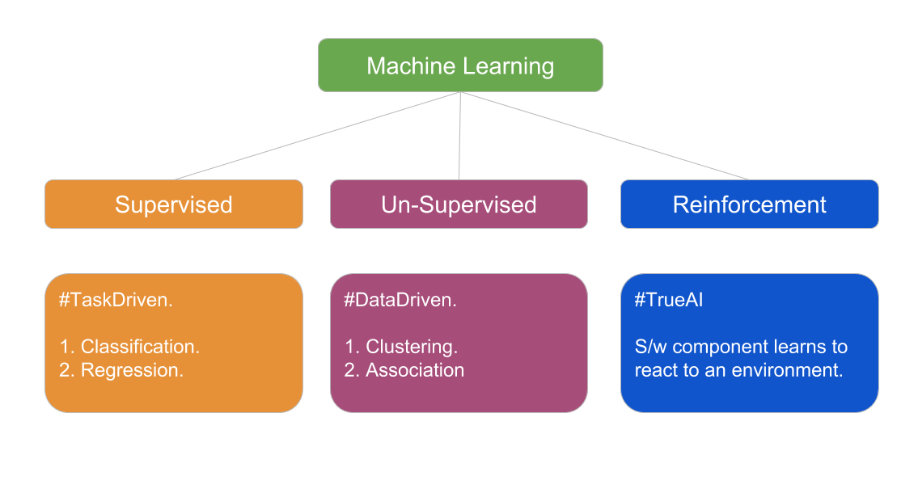

Slide 5
Supervised & Unsupervised Learning
SL
Learn from others
Features and Labels
Regression & Classification
USL
Learn on own
Only features
Clustering and Association

Slide 6
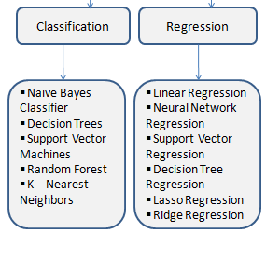
Types of ml algorithms (SL)
Linear regression
Logistic regression
Non linear regression
Decision tree
Random forest
K nearest neighbour
SVM support vector machine
Naive bayes

Slide 7
Linear regression - It is the supervised Machine Learning model in which the model finds the best fit linear line between the independent and dependent variable
Non linear regression - It is a statistical technique that helps describe nonlinear relationships in experimental data
Logistic regression - It is used to calculate or predict the probability of a binary (yes/no) event occurring

Slide 8
Decision Trees - The data is continuously split according to a certain parameter. The tree can be explained by two entities, namely decision nodes and leaves.
Random forest - It builds decision trees on different samples and takes their majority vote for classification and average
K-nearest neighbors – It uses proximity to make classifications or predictions about the grouping of an individual data point.
Support vector machine - Vectors are data points that are closer to the hyperplane and influence the position & orientation of the hyperplane
Naive bayes - It is a probabilistic classifier, which means it predicts on the basis of the probability of an object.

Slide 9
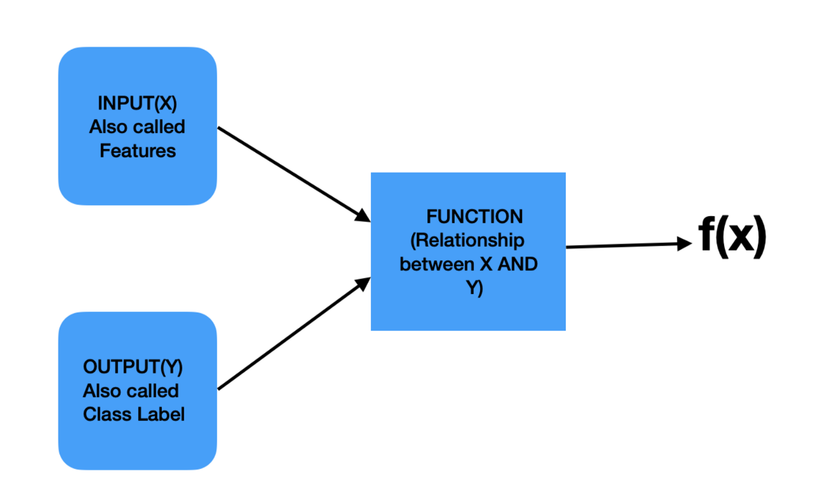
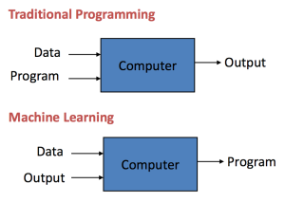
Features, labels & functions

Slide 10
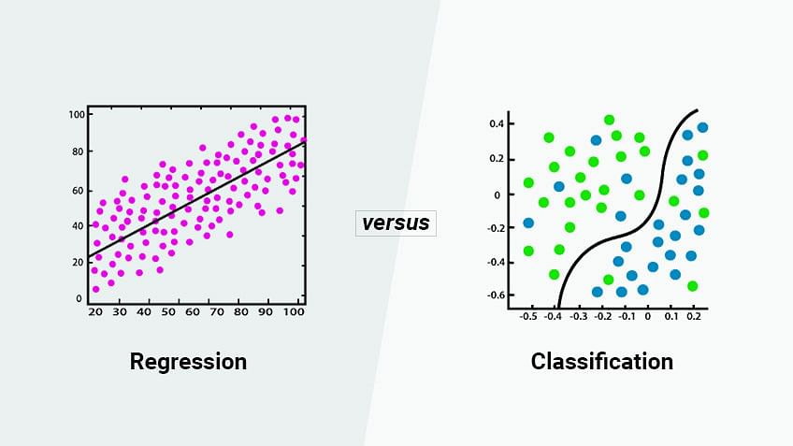
Types of Supervised learning

Slide 11
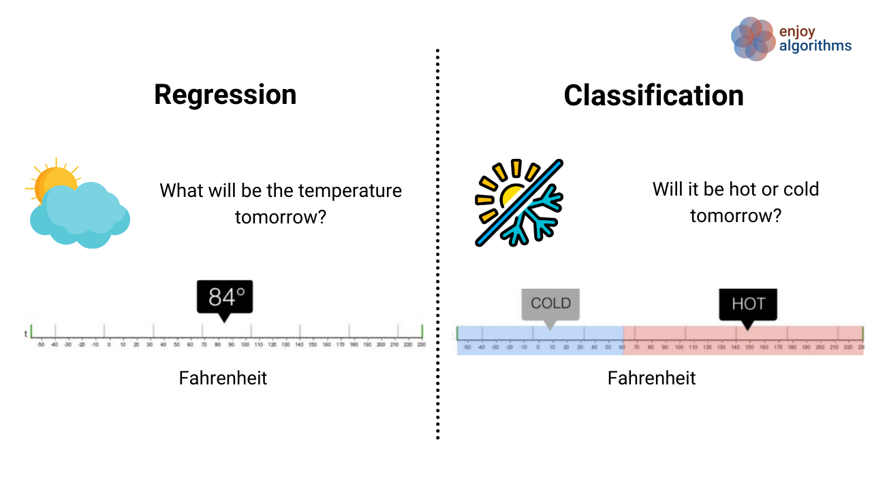
It is a continuous mode of data
Classifying things based on a particular point

Slide 12
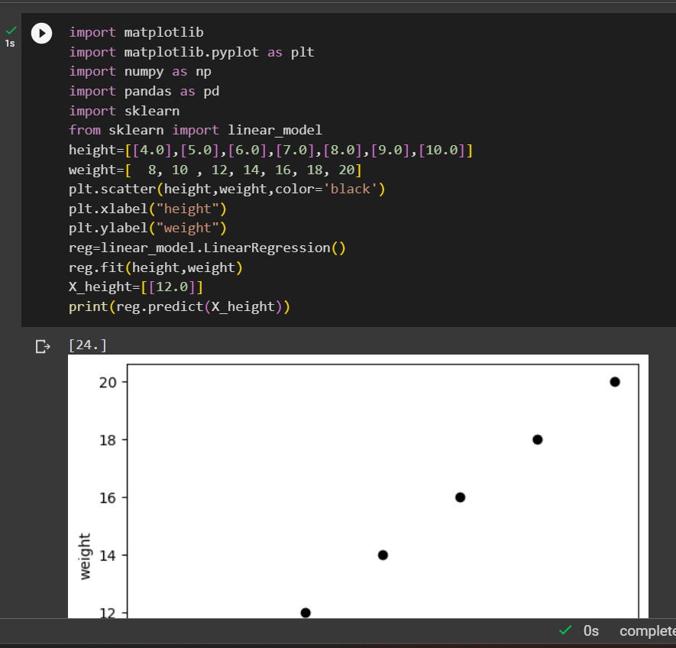
Linear regression

Slide 13
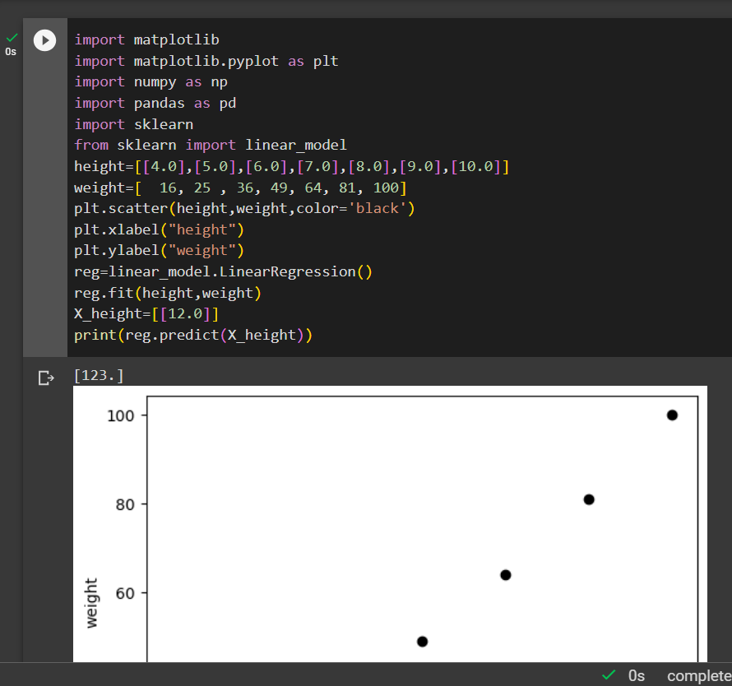
Non – linear regression

Slide 14
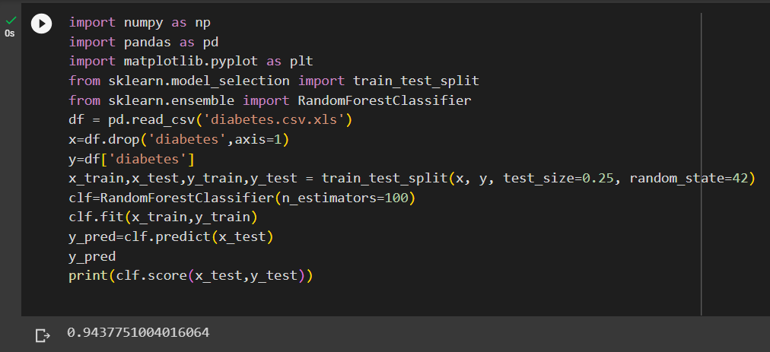
Random forest

Slide 15
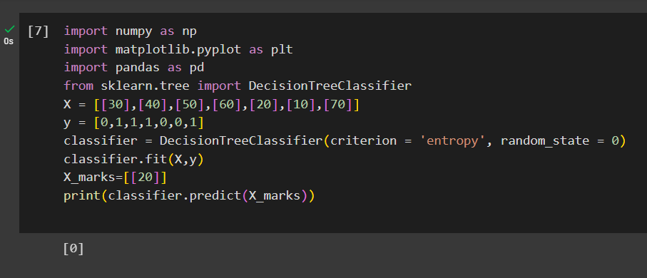
Decision tree

Slide 16
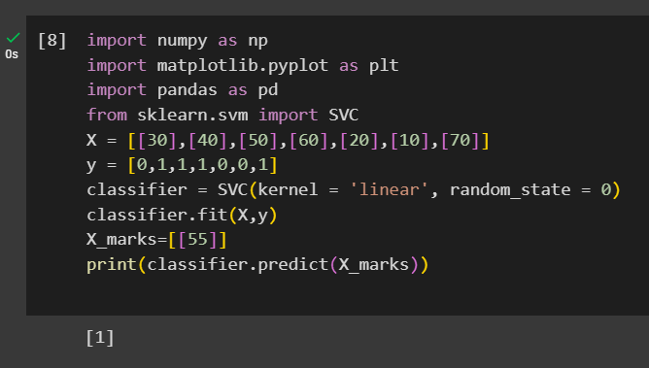
Svm (Support vector mission)

Slide 17
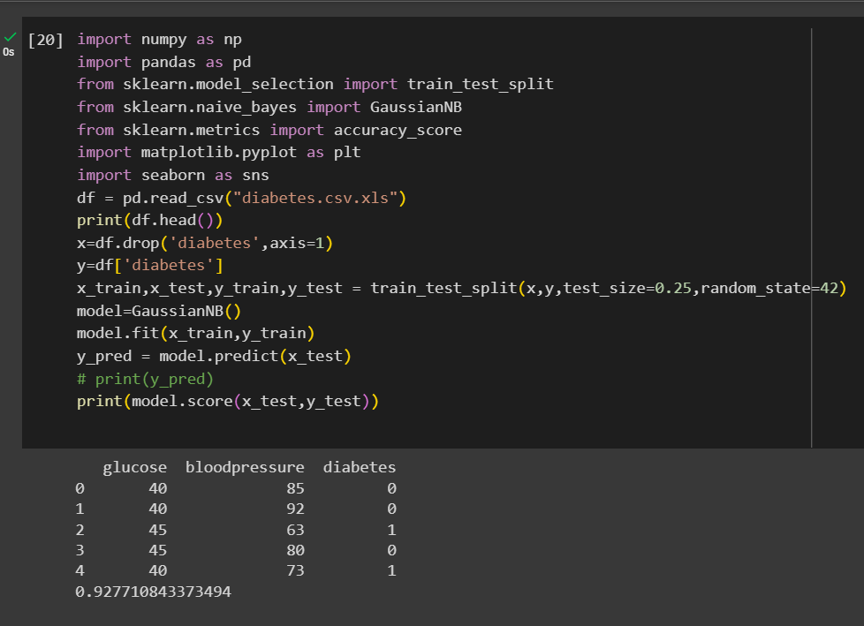
Naïve bayes

Slide 18
T
A
K
H
N
O
Y
U

